Slide 1
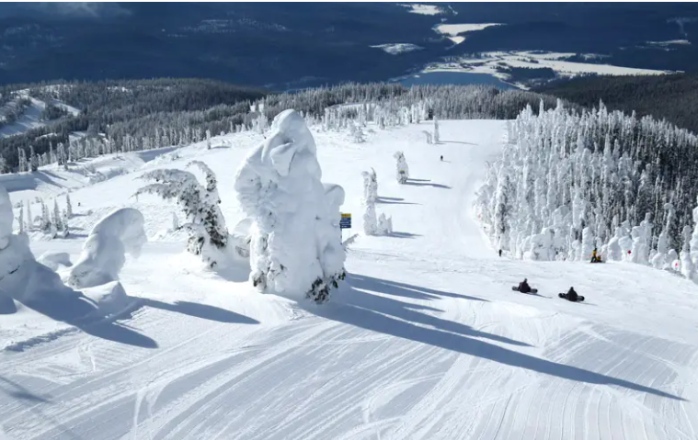
Big Mountain Ski Resort Ticket Price modeLing
Puja Patidar
July 2025

Slide 2
Problem Identification
How Big Mountain Resort reduce its operating costs and identify which resort facility justify the increased ticket price in this season.
Big Mountain Resort, a ski resort located in Montana offers spectacular views of Glacier National Park and Flathead National Forest, with access to 105 trails. Big Mountain Resort is a ski resort in Montana serving 350,000 people every year.
They have recently installed a chair lift, which increased their operating costs by $1,540,000 this season.
The business wants to transition from an average-based pricing strategy to a data-informed pricing model.
Big Mountain resort management wants to evaluate whether
They should cut operating costs without lowering ticket prices
Enhance offerings to justify a higher ticket price that enhances profitability.

Slide 3
Dataset Overview
A Dataset has 330 resorts and 27 features
Key Columns: Name, Region, State, Ticket Prices, Facilities with features such as
vertical drop, skiable area, snow-making capability, number of lifts, Weekday and weekend process.
Data Observations:
FastEight column had > 50% missing values so we dropped it.
Ticket price columns had 15–16% missing value so we dropped column with more missing values.
In Silverton Mountain resort corrected SkiableTerrain_ac value i.e.1819.

Slide 4
Key Findings and Recommendations
KEY FINDINGS
RECOMMENDATIONS
Scenarion1: Permanently closing down up to 10 of the least used runs.
Closing one run makes no difference, closing 2 and 3 successively reduces support for ticket
Scenario 2: Increase the vertical drop run to 150 feet and installation of an additional chair lift.
This scenario increases support for ticket price by $1.99. this could be expected to amount to $3.47M, (expected_visitors = 350000)
Scenario 3: Scenario 2 with addition of 2 acres of snow-making cover
Increases ticket price by $1.99, this could be expected to amount to $3.47M. A small increase in the snow-making area makes no difference.
Our ticket is undervalued currently; we can increase out price from $81 to $85.48 without loosing any customer
Closing one run makes no difference, closing 2 and 3 successively reduces support for ticket
Increase the vertical drop run by 150 feet and installation of an additional chair lift support for ticket price by $1.99, so as a result we can increase revenue up to $3.47M per session

Slide 5
Modelling Price
The current ticket price of the ski resort is $81.00
The model predicts a supported price of $95.87,
with a mean absolute error (MAE) of ±$10.39, this suggests there is room for an increase ticket price.
This results in a confidence range of $85.48 to $106.26. Based on this:
The price of ticket can be confidently increased to at least $85.48 without any concern.
Additionally, the planned improvement (increasing vertical drop and adding a chairlift) supports an extra increase of $1.99
This scenario is increasing the recommended price range to $85.48–$87.47

Slide 6
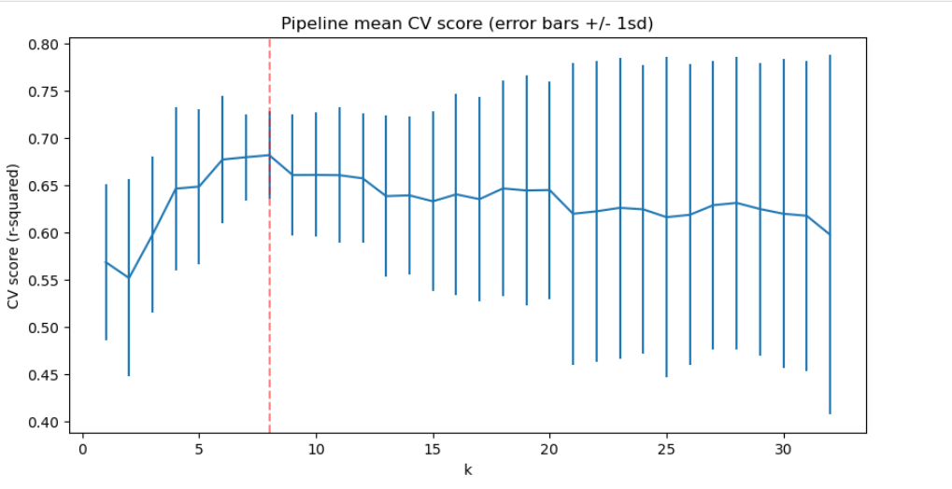
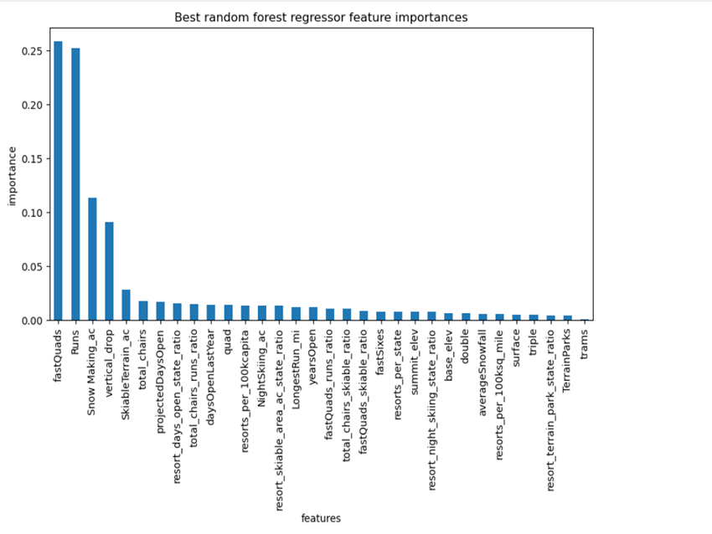
Regression Model Performances
Linear Regression Model performance
Random Forest Regression Model performance
Mean :10.499032338015295,
Std 1.6220608976799666
Mean absolute error : 11.793465668669324
Mean 9.644639167595688,
std 1.3528565172191818
Mean absolute error: 9.537730050637332

Slide 7
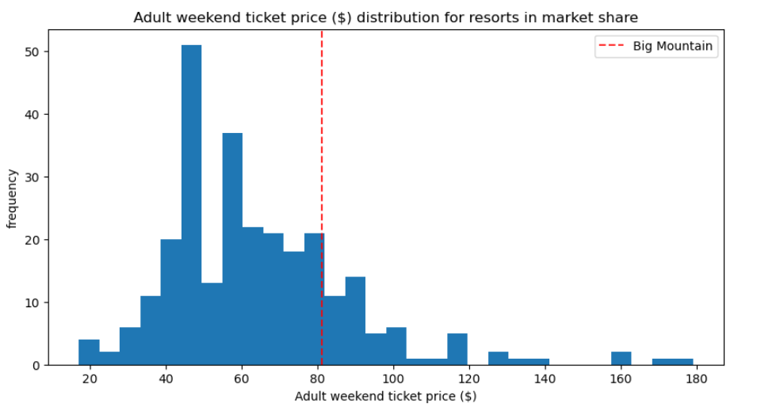
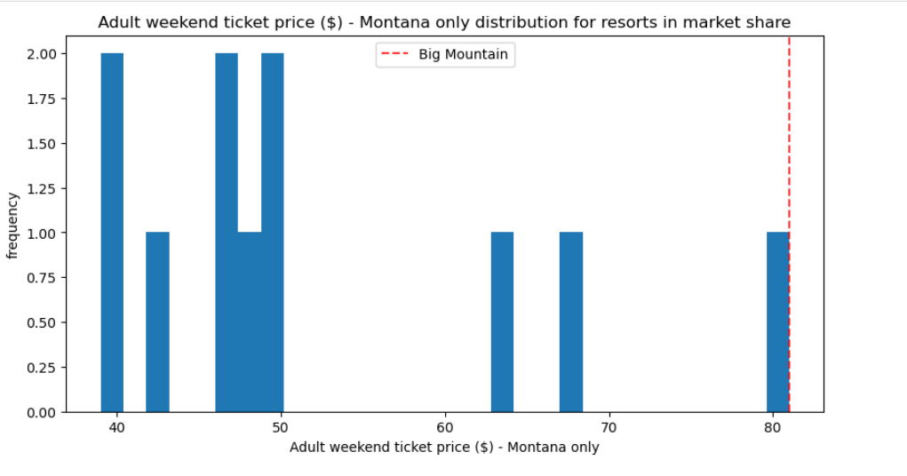
Regression Model – Top Features
Linear Regression Model
Random Forest model
Biggest positive feature with linear regression model
vertical_drop
Snow Making_ac
total_chairs
fastquads
Runs
Encouragingly, the dominant top four features are in common with linear model:
fastQuads
Runs
Snow Making_ac
vertical_drop
Price of Big Mountain resort in market share

Slide 8
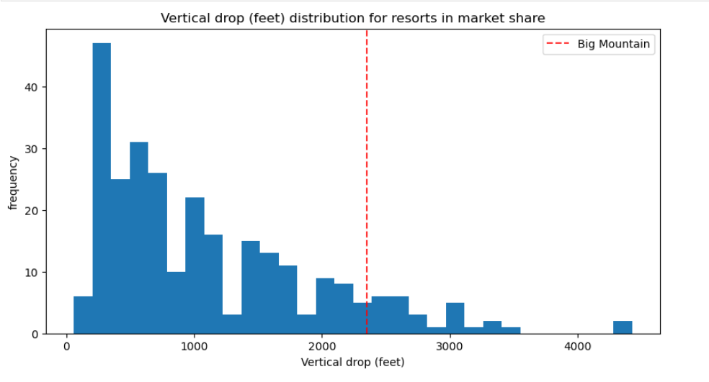
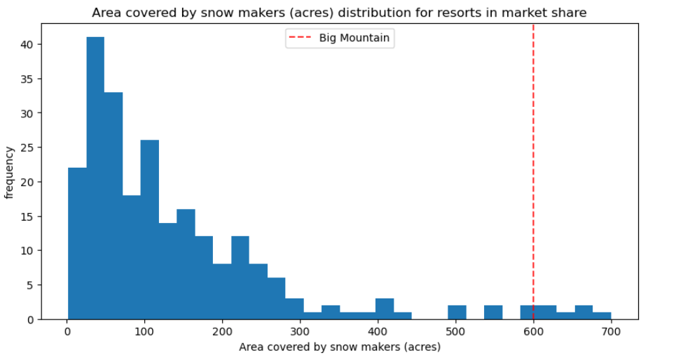
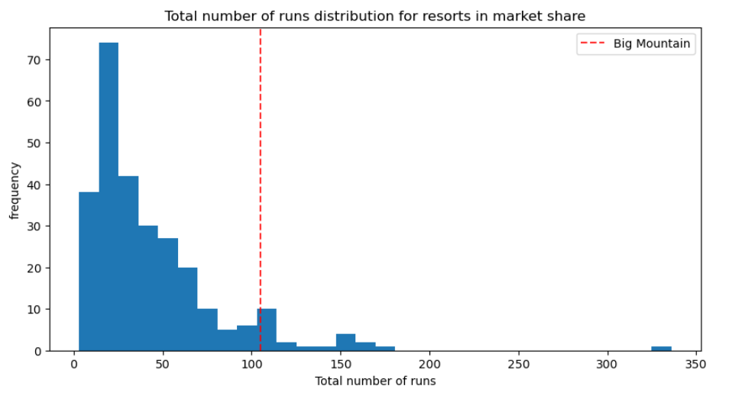
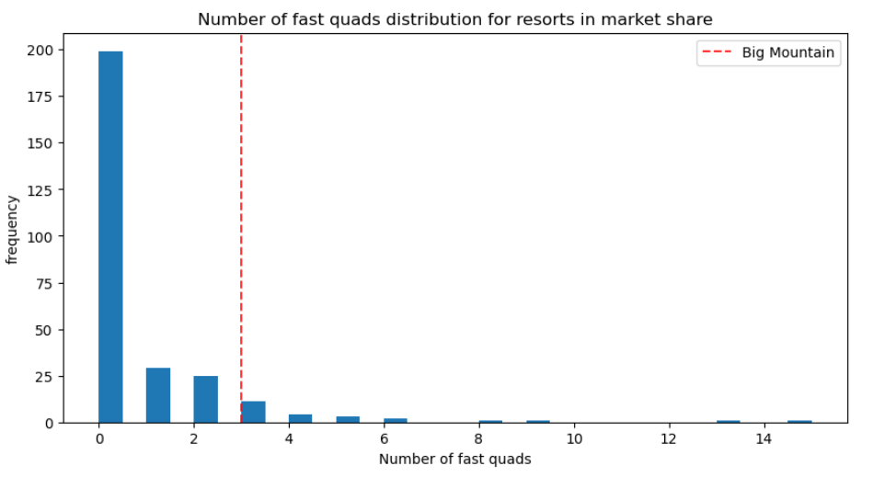
Big Mountain Resort In Market Context

Slide 9
Summary and Conclusion
Big Mountain resort Currently ranks among the top resorts with following features
Snow making capacity
Number of Chairs
Number of Runs
Skiable terrain
fastquads
By increasing the vertical drop either with or without snowmaking will provide the opportunity to increase revenues by 3.47 million, however the increase cost of tickets must be considered.

